Slide 1
INTRODUCTION TO DATA STRUCTURE
By Prof. Ayush Gour

Slide 2
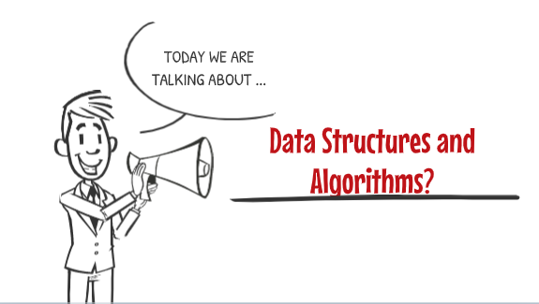

Slide 3
Introduction
Data means value or set of values . Data items refers to a single unit of values.
Data is represented in the from of text/numbers/figures/ tables/graphs/pictures etc. A computer language is incomplete without data.
Information is derived from data, such as:
per capita income, Average Population of the states , price index ,etc.
Data
Method to Process data
I
N
F
O
R
M
A
T
I
O
N

Slide 4

Then What’s Information?
Lets take Example..

Slide 5

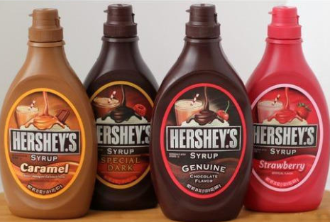
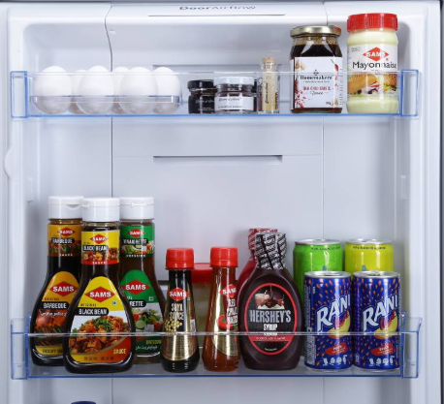
A
B
C

Slide 6
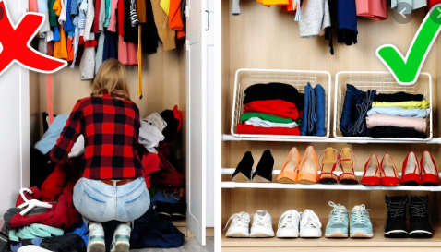
Which one is Structured?
A
B

Slide 7
Introduction
In a month we everyday get the newspaper then at the end we can calculate the bill from the data of the cost of newspaper we daily receive.
Data about some persons in a group:
Information Details | Data
Name | Satish
Gender | Male
Age | 32
Phone | 987680987

Slide 8
From the score of an individual cricket player we can draw following information:
  Highest score
  Total Runs Scored
  Average
  Strike rate
  No. of Sixes
  No. of fours
This information helps the planners/analysts/to make decisions.
Info. in Computer: A computer is an electronic device that manipulates the information presented in the form of data.
Data: Data is nothing but a collection of numbers, alphabets and symbols combined to represent information.
Entity: An entity possesses some attributes and some values can be allocated to it. E.g. student entity in a college.

Slide 9
Overview of Data Structures
Data Structures are a method of representing of logical relationships between individual data elements related to the solution of a given problem.
A data structure is a structured set of variables associated with one another in different ways, co-operatively defining the components in the system and capable of being operated upon in the program.
Data structures are the basis of the programming tools. The choice of data structures should provide the following:
  The data structure should satisfactorily represent the relationship between the data elements.
  The data structure should be easy so that the programmer can easily process the data.

Slide 10

Efficient?

Slide 11


Slide 12
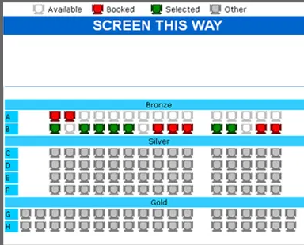

Slide 13
Classification of Data Structures
Linear: The values are arranged in a linear way. E.g. Arrays, Linked Lists, Stacks, Queues etc.
Non-Linear: The values are not arranged in an order. E.g. Tree, Graph.
Homogeneous: Here all the values stored are of same type e.g. arrays
Non- Homogeneous: Here all the values stored are of different type e.g. structures and classes.
Dynamic:A dynamic data structure is one that can grow or shrink as needed to contain the data you want stored. That is, you can allocate new storage when it's needed and discard that storage when you're done with it. E.g. pointers.
Static:They're essentially fixed-size and often use much space E.g. Array

Slide 14
Basic Notations
Algorithmic Notations:
Finite step by step list of well-defined instructions for solving a particular problem.
Formal presentation of the Algorithm consists of two parts:
    A paragraph that tells the purpose of an algorithm. Identifies the variables which occur in the algorithm and lists the input data.
    The list of the steps that is to be executed.
Some conventions used in Algorithms:
    Identifying Number (Algorithm 2: )
    Steps, Control and Exit ( All statements are numbered, Go to and Exit)
    Comments (The comments are to be given to understand the meaning)
    Variable Names (capital letters are used for variable names)
    Assignment Statement (Max:=DATA[1])
    Input and output (Read: variable names, Write: Messages and/or variable names)
    Procedure

Slide 15
Basic Notations
Control Structures:
Sequential Logic or Sequential Flow
Selection Logic or Conditional Flow
    If (condition) Endif
    If (condition) Else Endif
    Multiple If Elseif Else Endif
Iteration Logic (Repetitive Flow)
Repeat for K=R to S by T:
[Module]
[End of Loop]

Slide 16
Types of Data Structures
Arrays:
Linear data structure
All elements stored at contiguous memory locations
Every element is identified by an index (Logical Address)
At the same time every element is identified by a physical address (Physical Address)
We can have 2D and 3D arrays also but stored in memory in a linear way.

Slide 17
Types of Data Structures
Stack:
  Only the top item can be accessed
  Can only extract one item at a time
A stack is a data structure with the property that only the top element of the stack is accessible
The stack’s storage policy is Last-In First-Out
Only the top element of a stack is visible, therefore the number of operations performed by a stack are few
Needs the ability to:
  Inspect the top element
  Retrieve the top element
  Push a new element on the stack
  Test for an empty stack

Slide 18
Types of Data Structures
Queue:
  Stores a set of elements in a particular order
  Stack principle: FIRST IN FIRST OUT
  = FIFO
  It means: the first element inserted is the first one to be removed
  Real life examples
    Waiting in line
    Waiting on hold for tech support
  Applications related to Computer Science
    Threads
    Job scheduling (e.g. Round-Robin algorithm for CPU allocation)

Slide 19
Types of Data Structures
Linked List:
A
B
C
∅
Head
A linked list is a series of connected nodes
Each node contains at least
  A piece of data (any type)
  Pointer to the next node in the list
Head: pointer to the first node
The last node points to NULL
node
A
data
pointer

Slide 20
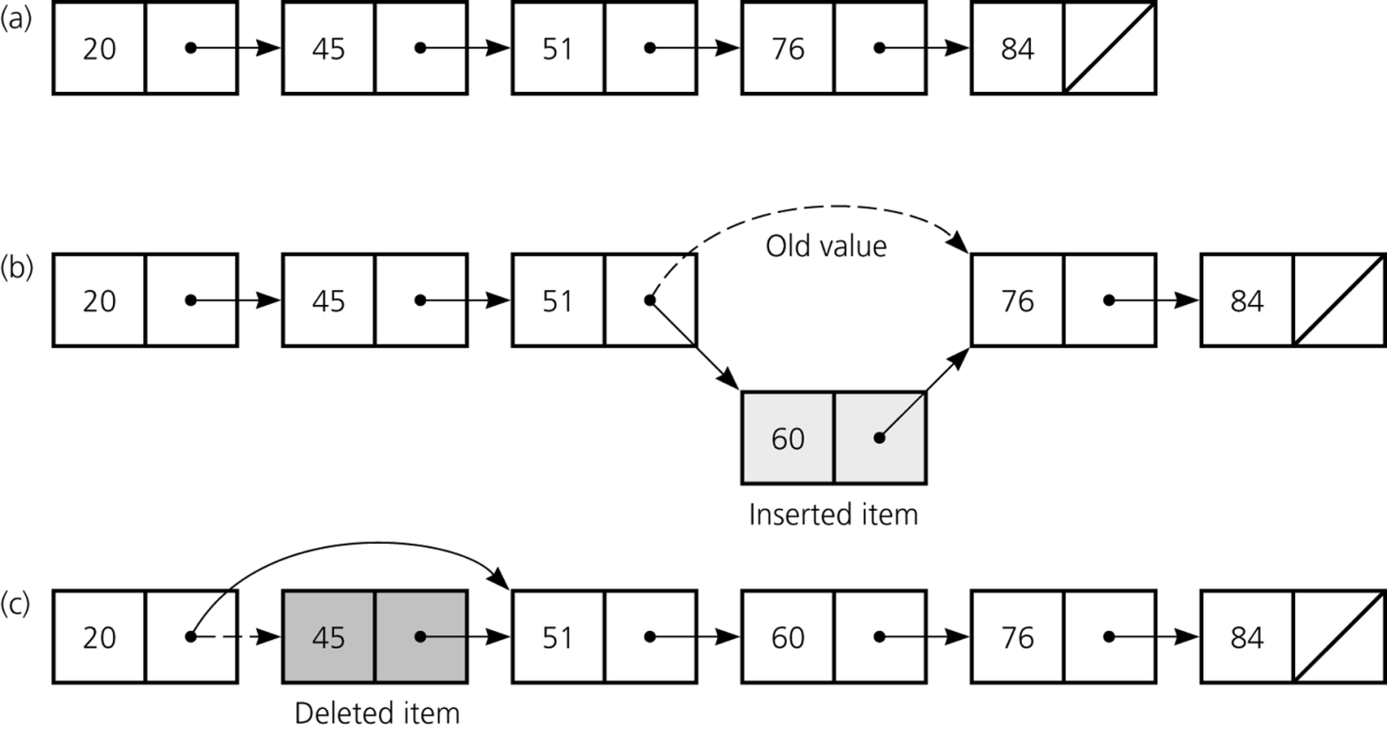
Types of Data Structures
Linked List:
Linear data structure.
Primarily used when the elements are to stored at non-contiguous locations.
Linked list is able to grow in size as needed.
Does not require the shifting of items during insertions and deletions.

Slide 21
Terminology for a Tree
Tree: A collection of data whose entries have a hierarchical organization
Node: An entry in a tree
Root node: The node at the top
Terminal or leaf node: A node at the bottom
Parent: The node immediately above a specified node
Child: A node immediately below a specified node
Ancestor: Parent, parent of parent, etc.
Descendent: Child, child of child, etc.
Siblings: Nodes sharing a common parent
Binary tree: A tree in which every node has at most two children
Depth: The number of nodes in longest path from root to leaf

Slide 22
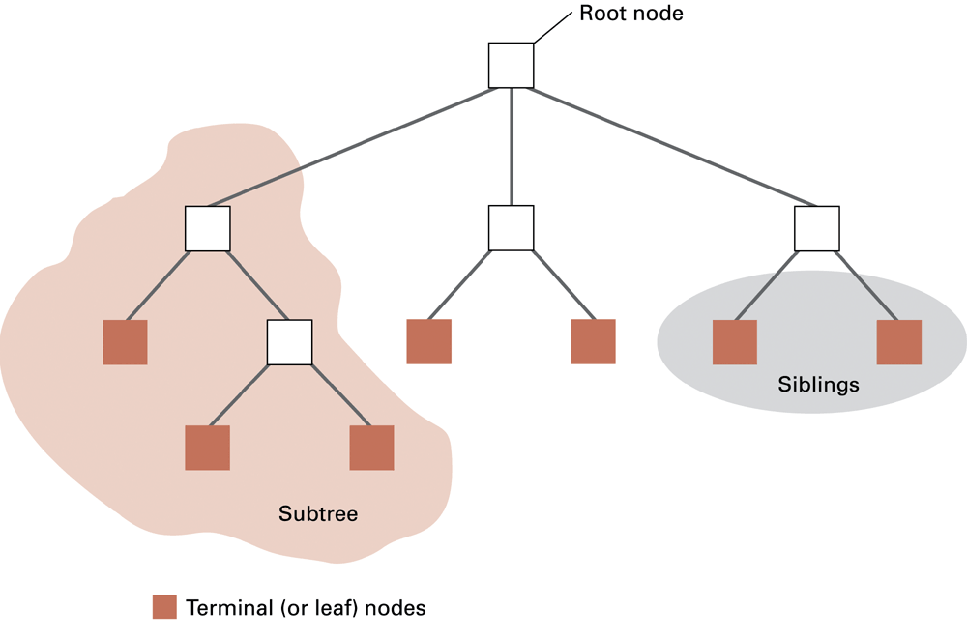
Tree Terminology

Slide 23
Graph
A graph is a pair (V, E), where
  V is a set of nodes, called vertices
  E is a collection of pairs of vertices, called edges
  Vertices and edges are positions and store elements
Example:
  A vertex represents an airport and stores the three-letter airport code
  An edge represents a flight route between two airports and stores the mileage of the route
849
PVD
1843
ORD
142
SFO
802
LGA
337
1743
1387
HNL
2555
1099
LAX
1233
DFW
1120
MIA
Graphs

Slide 24
Edge Types
Directed edge
  ordered pair of vertices (u,v)
  first vertex u is the origin
  second vertex v is the destination
  e.g., a flight
Undirected edge
  unordered pair of vertices (u,v)
  e.g., a flight route
Directed graph
  all the edges are directed
  e.g., route network
Undirected graph
  all the edges are undirected
  e.g., flight network
Flight AA 1206
ORD
PVD
849 miles
ORD
PVD

Slide 25
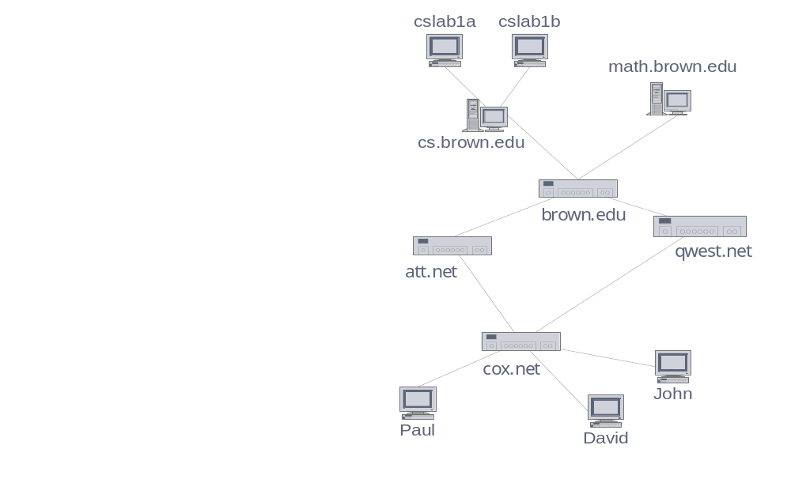
Applications
Electronic circuits
  Printed circuit board
  Integrated circuit
Transportation networks
  Highway network
  Flight network
Computer networks
  Local area network
  Internet
  Web
Databases
  Entity-relationship diagram

Slide 26
Complexity Analysis and
Time-Space trade-off

Slide 27
Complexity
A measure of the performance of an algorithm
An algorithm’s performance depends on
  internal factors
  external factors

Slide 28
External Factors
Speed of the computer on which it is run
Quality of the compiler
Size of the input to the algorithm

Slide 29
Internal Factor
The algorithm’s efficiency, in terms of:
Time required to run
Space (memory storage) required to run
Note:
Complexity measures the internal factors (usually more interested in time than space)

Slide 30
Need for analysis
To determine resource consumption
  CPU time
  Memory space
Compare different methods for solving the same problem before actually implementing them and running the programs.
To find an efficient algorithm

Slide 31
Two ways of finding complexity
Experimental study
Theoretical Analysis

Slide 32
Experimental study
Write a program implementing the algorithm
Run the program with inputs of varying size and composition
Get an accurate measure of the actual running time
Use a method like System.currentTimeMillis()
Plot the results

Slide 33
Theoretical Analysis
Uses a high-level description of the algorithm instead of an implementation
Characterizes running time as a function of the input size, n.
Takes into account all possible inputs
Allows us to evaluate the speed of an algorithm independent of the hardware/software environment

Slide 34
Space Complexity
The space needed by an algorithm is the sum of a fixed part and a variable part
The fixed part includes space for
  Instructions
  Simple variables
  Fixed size component variables
  Space for constants

Slide 35
The variable part includes space for
  Component variables whose size is dependant on the particular problem instance being solved
  Recursion stack space
  etc..

Slide 36
Time Complexity
The time complexity of a problem is
  the number of steps that it takes to solve an instance of the problem as a function of the size of the input (usually measured in bits), using the most efficient algorithm.
The exact number of steps will depend on exactly what machine or language is being used.
To avoid that problem, the Asymptotic notation is generally used.

Slide 37
Time Complexity
Worst-case
  An upper bound on the running time for any input of given size
Average-case
  Assume all inputs of a given size are equally likely
Best-case
  The lower bound on the running time

Slide 38

Time Complexity – Example
Sequential search in a list of size n
  Worst-case:
    n comparisons
  Best-case:
    1 comparison
  Average-case:
    n/2 comparisons
The algorithm runs in linear time
  Linear number of operations
… | … | … | … | … | … | …
n

Slide 39
Algorithms Complexity
Algorithm complexity is rough estimation of the number of steps performed by given computation depending on the size of the input data
  Measured through asymptotic notation
    O(g) where g is a function of the input data size
  Examples:
    Linear complexity O(n) – all elements are processed once (or constant number of times)
    Quadratic complexity O(n²) – each of the elements is processed n times

Slide 40
THANK YOU

